Slide 1
Geocaching 101
Brought to you by members of the Wisconsin Geocaching Association
June 2020

Slide 2
Disclaimers
We are sharing our combined experience recognizing that geocaching has and continues to evolve.
Our comments are ours alone and may not necessarily reflect any official stance of the Wisconsin Geocaching Association.
We are volunteering our time.

Slide 3
Agenda
01
02
03
04
Basics
Getting Started
What are all these terms?!
Create an account and find your first cache!
Best Practices
Advanced Topics
Do’s and Don’ts.
Trackables, Pathtags, alternative apps, and more.

Slide 4
01
Basics
What are all these terms?!

Slide 5
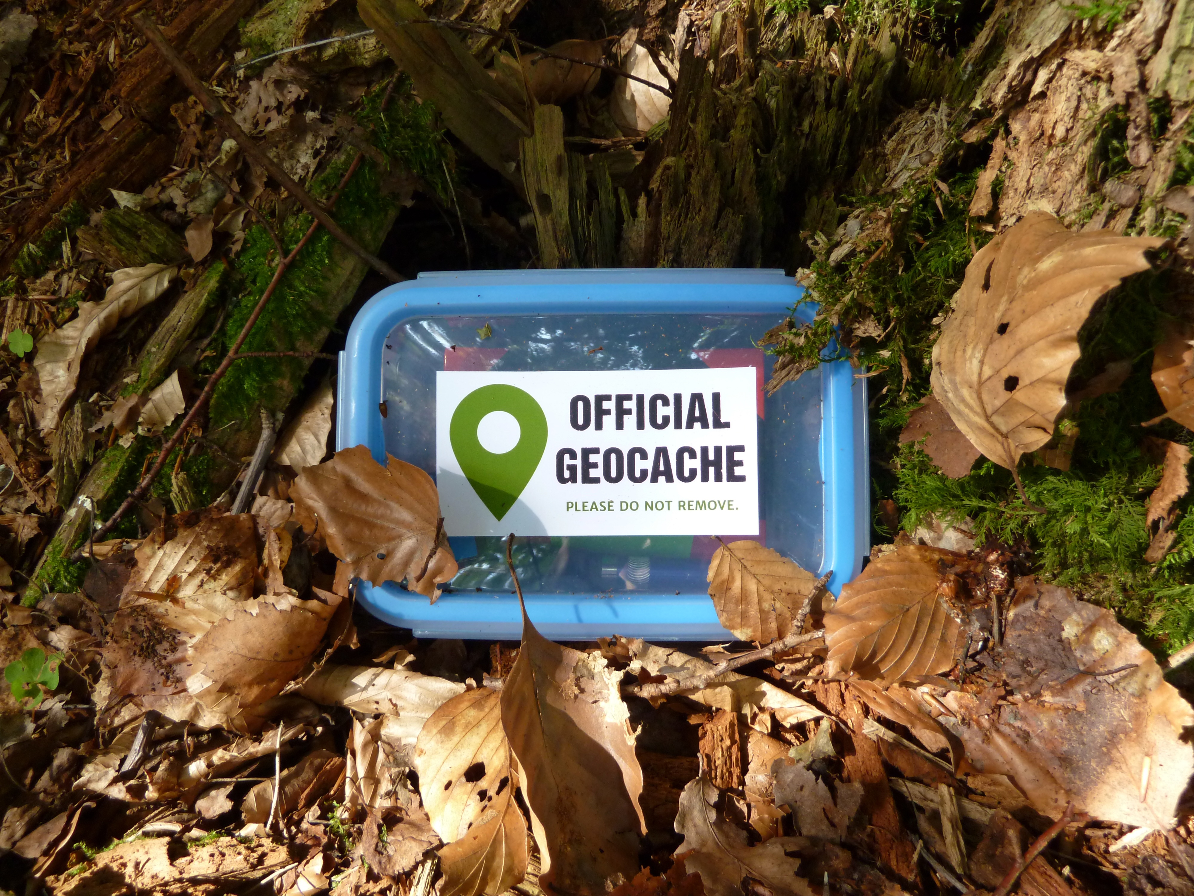
What is Geocaching?
Combination of Technology, Nature, and Fun!

Slide 6
What is Geocaching?
Geocaching is an eco-sport or outdoor adventure game for GPS users of all ages.
There are over 3 million active geocaches and over 1 million active geocachers worldwide.
You’ll find places you never knew existed!

Slide 7
Geocaching Widow
As someone that doesn’t cache a lot at all but is married to a very experienced cacher, Uncle_Fun, I have still reaped many benefits - the places we have visited, are many times unexpected and beautiful - never would have known about them without caching. The people we have met? So many nice people! Several are now considered very close friends of mine. Last but not least- as a couple we have taken some amazing trips as a result. Be open to new experiences and join in on the fun as little or as much as you want.

Slide 8
Who Goes Geocaching?
Anybody and everybody who enjoys the outdoors and looking for treasure!
Families with kids.
People looking for something to do while walking their dog.
Solo geocachers of all ages.

Slide 9
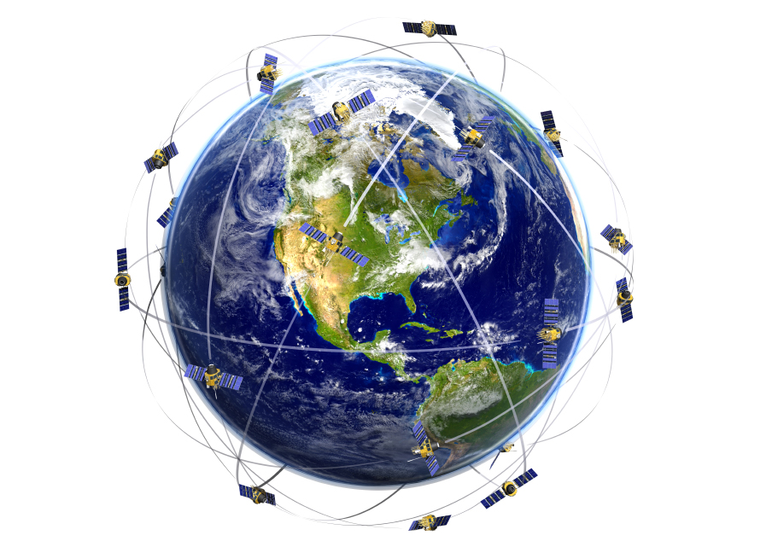
What is GPS?
GPS stands for Global Positioning System.
As of February 2019, the system contains 31 satellites (27 active, 4 reserve) in low Earth orbit that continuously broadcast their position.
GPS makes our hobby possible!
Notes:
Could mention selective availability here. Prior to May 2000, civilian GPSr units received signals with intentionally degraded signals. Selective availability was eliminated in May 2000, and the first geocache was placed shortly thereafter.

Slide 10
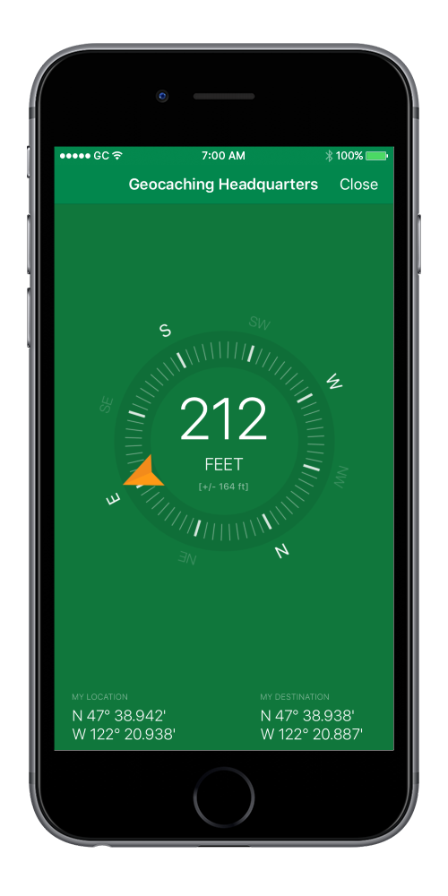
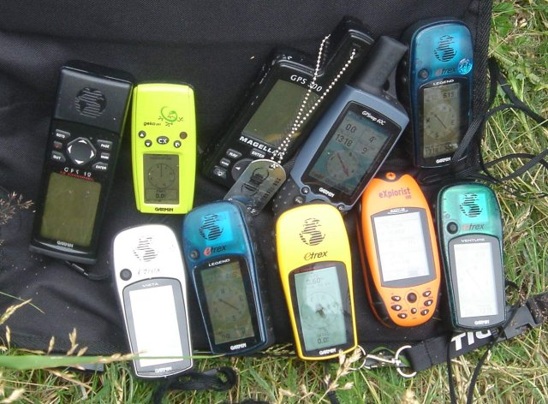
What is a GPSr?
GPS receivers are personal devices that display their current location and help the user navigate to another location.
The term GPSr often refers to a dedicated device.
Today’s smartphones double as GPSrs when paired with the right app(s).
Notes:
There’s a great debate over which type of device is better. These days they are similar in terms of accuracy, but there are trade-offs with both. A GPSr will take longer to get a lock but will generally hold it better outdoors. A smartphone will usually obtain location quickly, but it may take a while for the accuracy to improve. GPSrs hate tall buildings while phones may do a bit better in cities.

Slide 11
What is a Geocache?
A geocacher hides a container somewhere in the world and posts the GPS coordinates online.
The container is the geocache!
Other players use a handheld device to search for it.
Caches can be hidden anywhere, from busy urban settings to the middle of the woods.
Your goal is to find the cache, sign the physical log inside, and share your experience online!

Slide 12
Douce Us 5
Contact an experienced cacher in your area with ANY questions, most of us are willing to share our knowledge with new cachers.

Slide 13
What is a Muggle?
Borrowed from the world of Harry Potter, the term muggle refers to someone who is not a geocacher.
Missing caches are sometimes said to be muggled, potentially removed by someone who is unaware of our game.
Geocaching doesn’t have to be secret, but drawing unnecessary attention can compromise caches.
Notes:
Clearly labeling a cache and including an information sheet inside explaining what it is can help prevent innocent muggling.

Slide 14
Acronyms
CO |  | Cache Owner
DNF |  | Did Not Find
FTF |  | First to Find
GZ |  | Ground Zero
PNG |  | Park 'n' Grab
TNLN |  | Took Nothing Left Nothing
TOTT |  | Tool of the Trade
Notes:
Geocachers love acronyms! This is not an exhaustive list. Acronyms may be region-specific, but these are just about universal.

Slide 15
02
Getting Started
Create an account and find your first cache!

Slide 16
An App or a Website?
It’s both!
All geocaches are listed on the geocaching.com website.
Many players choose to use a smartphone app to access the online database of geocaches. Others use a computer and dedicated GPSr.
Since a smartphone app is the easiest way to get into geocaching, that’s what we plan to cover in this presentation.
You can do many of the same things and more using geocaching.com.

Slide 17
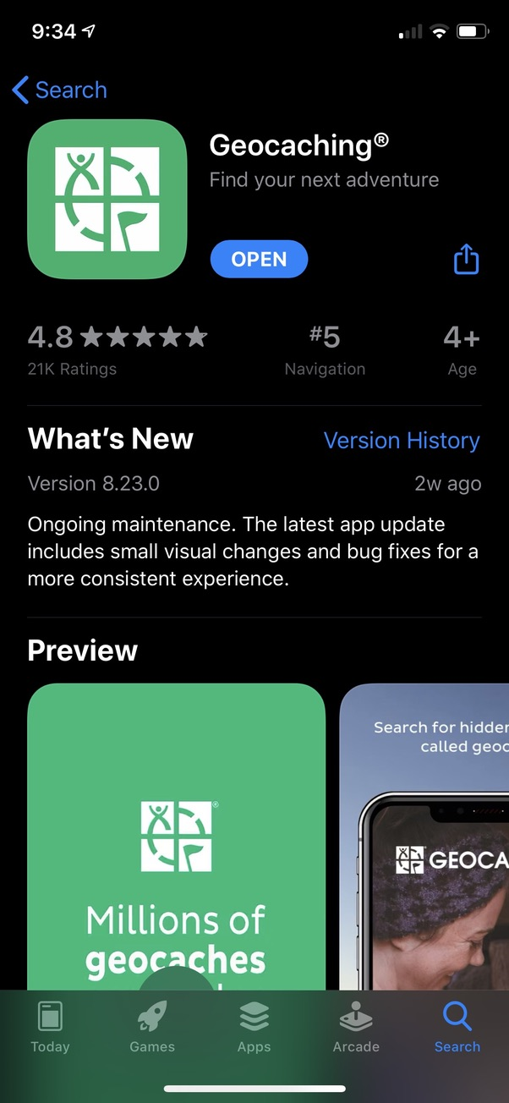
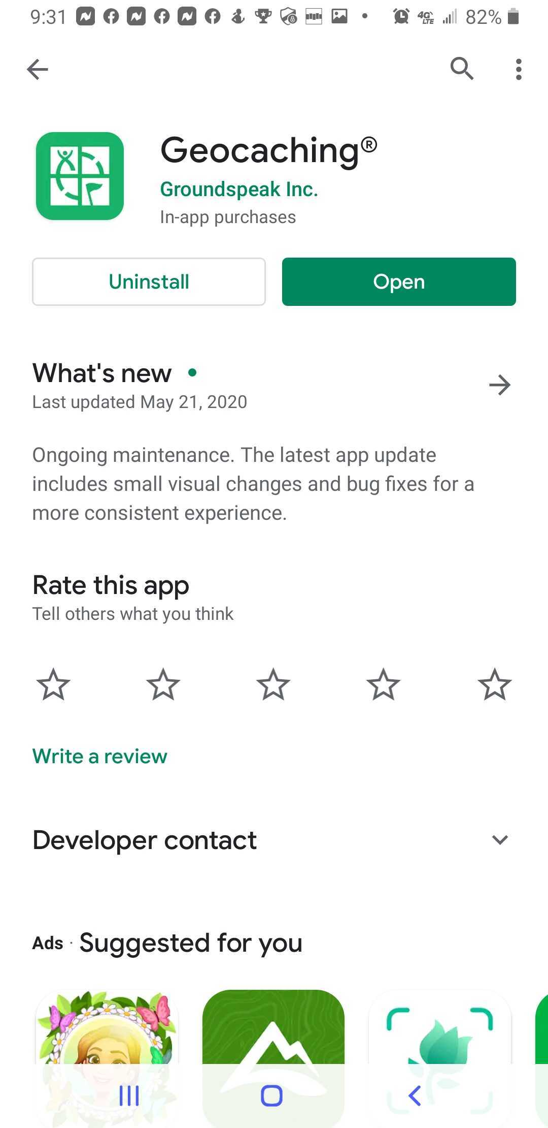
Download the App
To create your account from your phone, you will need the Geocaching app released by Groundspeak Inc. available for iOS and Android devices.
The app is free.

Slide 18
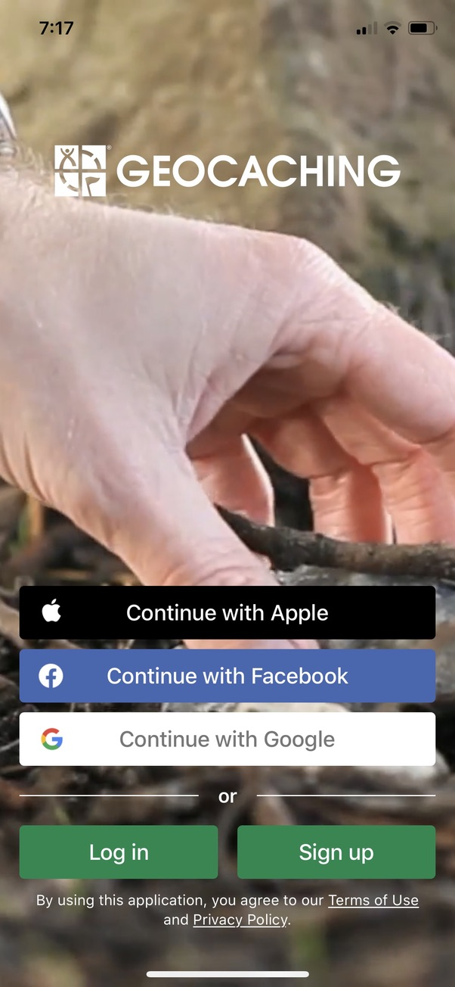
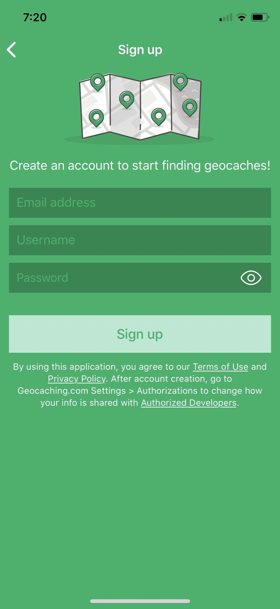
Create an Account
Login using a third-party provider OR
Create an account directly with geocaching.com (shown here)

Slide 19
Choose Your Username Wisely!
This is the name by which you will be known online and in the community, even after you meet other geocachers in person.
You’ll also be signing it on every log (some of them tiny), so consider keeping it shorter or choose something you can abbreviate.
Be creative but keep it family friendly.
If you decide you aren’t happy with your choice, you can change it later.

Slide 20
mate dulce
While the find is always exciting, the hiking, the scenery, and the time spent together is the true prize.

Slide 21
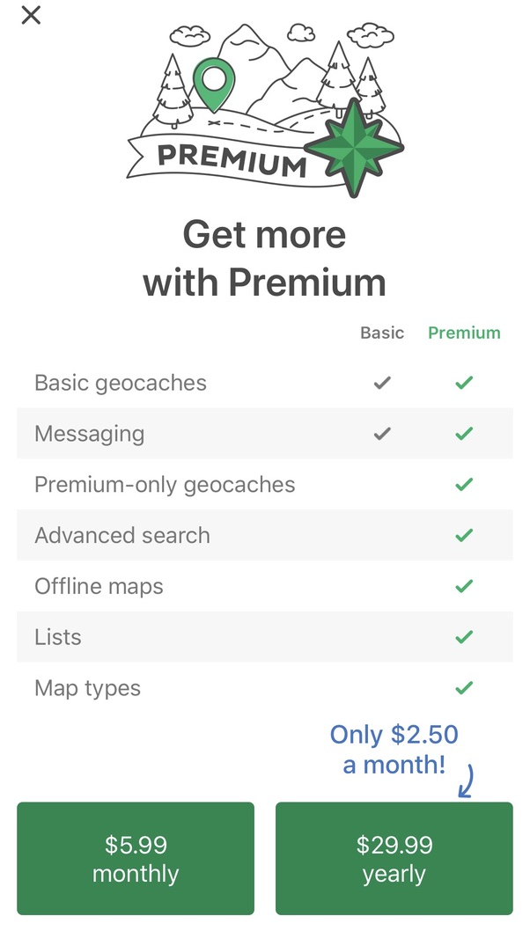
Membership Types
You can play for free with a Basic membership that has restrictions (fewer on the website).
Upgrade to Premium membership to eliminate restrictions and access more features.
Notes:
Premium membership has stayed the same price since it was introduced.
The cost is cheaper than the cost to take an average family to one movie.

Slide 22
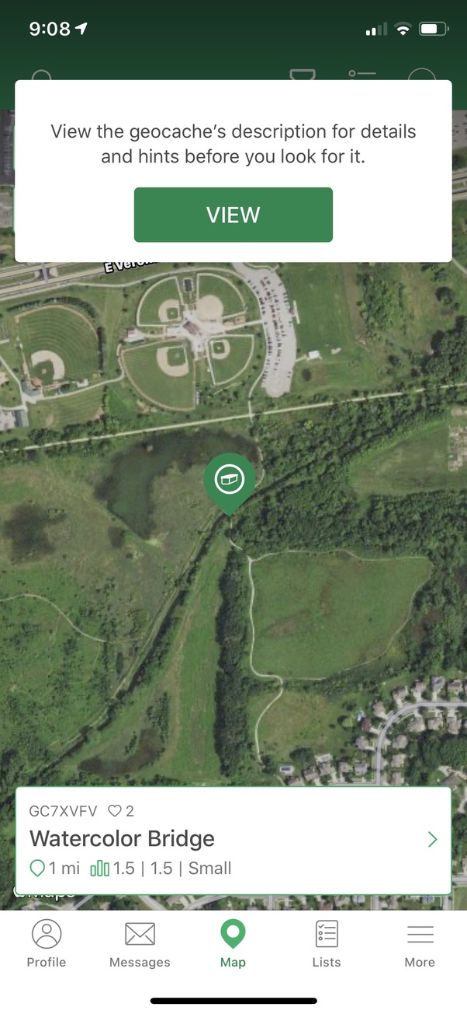
Choose Your First Geocache
After creating your account, the app will automatically direct you to a nearby traditional cache.

Slide 23
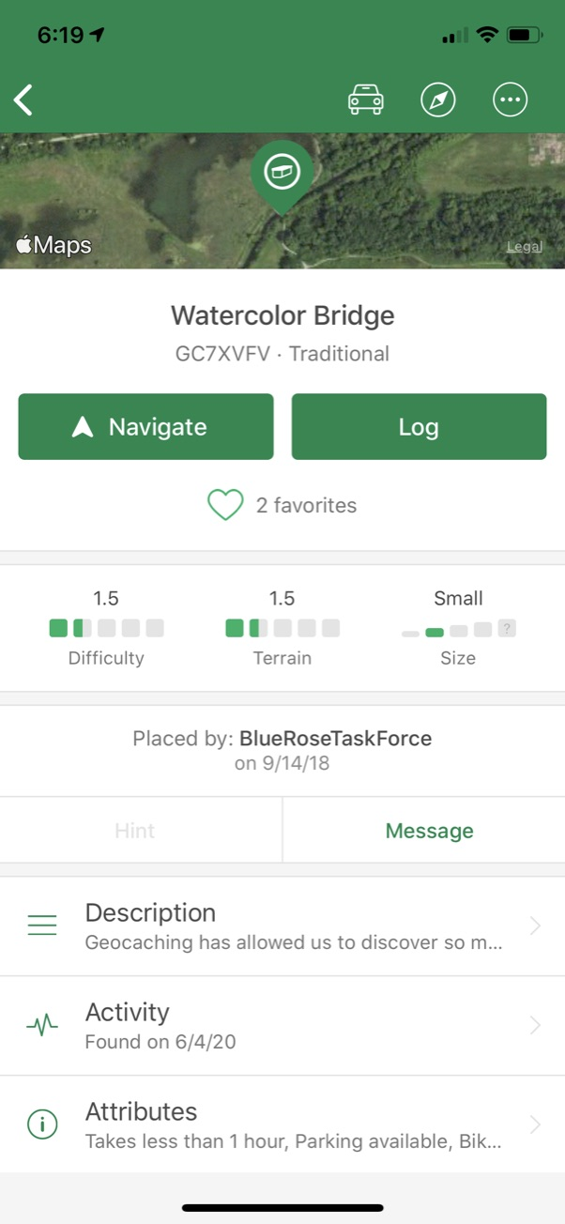
Cache Details
Difficulty and terrain ratings measured from 1 to 5 with half-step increments give you an idea of what to expect. Start with lower ratings for a better success rate.
Container size gives you some idea of what you’re looking for and where it could be hidden. Small to large usually have room for SWAG and trackables. Micro – Film canister or smaller Small – Sandwich container Regular – Shoe box Large – 5-gallon bucket Other – Doesn’t fit another category
The owner is responsible for this cache.
Message the owner about this cache.
The hint might help if you’re struggling. No promises, though. (No hint here.)
Read the description! It often contains important details.
Attributes tell you more about the hide and terrain along the way.
Logs from recent finders might also hold clues.
Notes:
Hint - do you check it right away or save it ‘til you struggle?

Slide 24
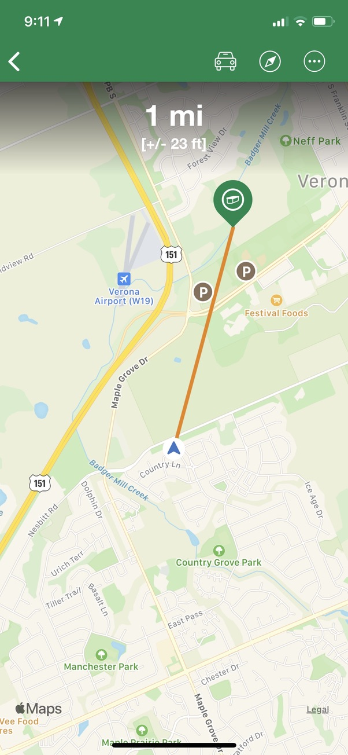
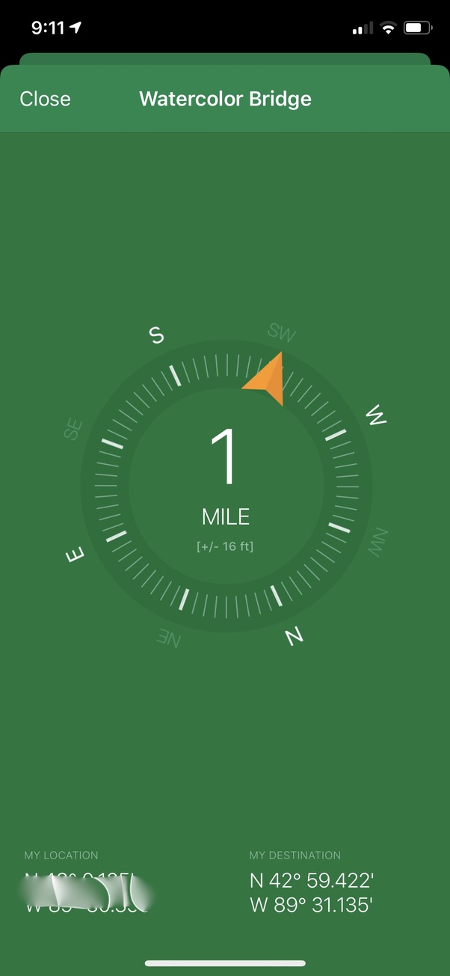
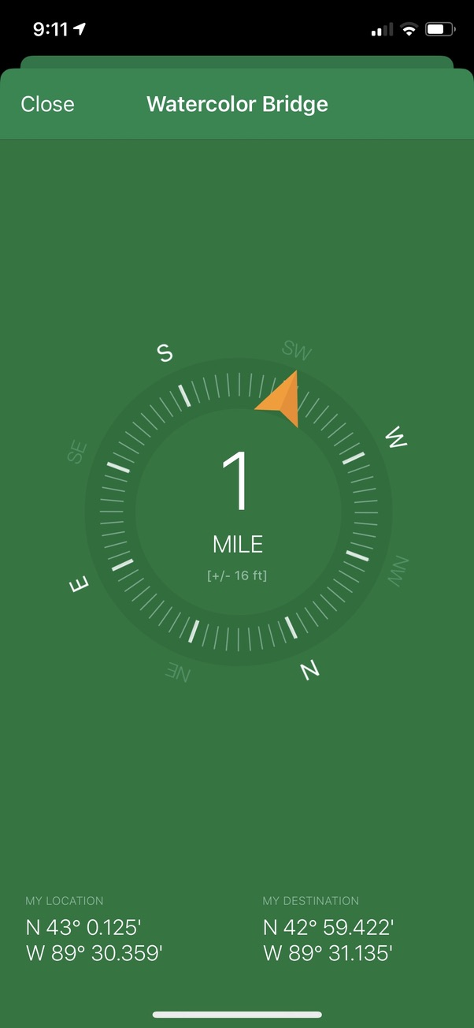
Go Get It!
Tap Navigate once to see a map view.
Tap the compass icon in the upper right for a simpler pointer view.

Slide 25
The Search
When you get near GZ, put your phone away!
Even a dedicated GPSr is only accurate to within about 20 feet.
Use your brain – where would you hide a container here?
It takes some practice, but you will eventually build up some “geo-sense” for where people like to stash containers.
Struggling? Change your thinking or perspective.
Expand your search area before declaring a DNF.
Notes:
You’ll rarely be standing on the cache when your device reads 0 feet.

Slide 26
MTCLMBR
It’s OK to DNF. We all do, even on the easy ones!

Slide 27
You Found It! Now What?
Get excited!
Open the container and sign the physical log inside (this is required!).
Trade items (optional).
Replace the cache exactly as you found it!
Tap the Log button to submit your find online OR
Save a draft to complete your online log later (Premium only).
Notes:
Don’t go into too much detail about do’s and don’ts here, more specifics come later.

Slide 28
TheOtherGuy
Log your DNFs. It might not feel good, but it will help others and the CO. And if you've got a couple DNFs going for you....aim for a nice P&G, so you can get your geo-mojo back.

Slide 29
03
Best Practices
Do’s and Don’ts.

Slide 30
WiscBikeGal
I cache alone, and being a woman, I am always keeping an eye on safety. And sometimes, you just don't feel like ducking into a scratchy, mosquito-filled, muddy woods. If you aren't dressed for walking in the woods, then go for the urban caches!

Slide 31
Safety
Make a plan and tell someone where you are going, especially when visiting remote areas.
Carry more water than you think you’ll need.
Understand the kind of wildlife you might encounter so you can tell the difference between harmless and dangerous.
Dress appropriately and carry supplies like water, sunscreen, bug spray, and more.
Know your limits. Stop if you’re uncomfortable. You don’t have to find every cache.
Have we mentioned lots of water?

Slide 32

Leave No Trace
Be a responsible geocacher.
Carry out your trash.
Stick to the trail as much as possible. The easiest path to the cache is not always a straight line!
Do your best not to disturb the natural fauna of an area.
Minimize your impact on the environment.

Slide 33
MTCLMBR
As a CO, I love descriptive logs and read every single log on my caches. It’s exciting to hear what your experience might have been.

Slide 34
Logging a Cache
Try to avoid short, generic logs like TFTC.
Take a moment to share your experience. Owners will appreciate it!
Mention the condition of the cache, especially if there is an issue.
Avoid spoilers in your log and/or photos. Subtle clues are OK, even appreciated by other cachers reading later.
Log your DNFs! They alert the cache owner of a potential problem.

Slide 35
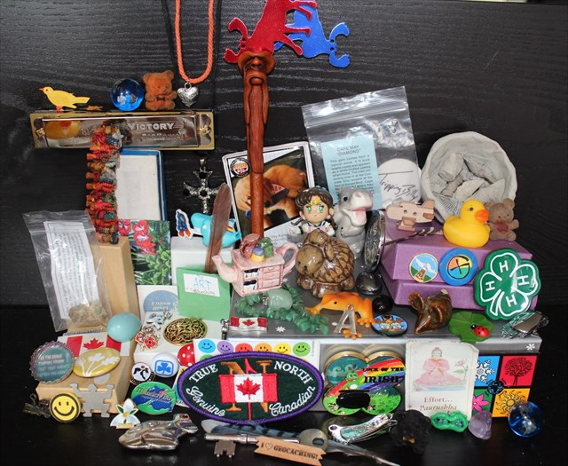
SWAG
Trade even, trade up, or do not trade at all.

Slide 36
Trading SWAG
Trade items are usually inexpensive trinkets, but they don’t have to be junk.
Good examples include small toys, key chains, magnets.
Some cachers make their own signature items to leave in caches.
Make sure whatever you’re trading fits in the container.
If you can’t trade, don’t take anything!
Notes:
SWAG is really a bad name. We only get some if we trade some!

Slide 37
More on SWAG
Keep it safe, legal, and family friendly.
Avoid alcohol, drugs, explosives, matches, lighters, knives, weapons, etc.
No soap bubbles or other liquids. (They explode!)
No food or heavily scented items. (Attracts wildlife!)
Remember that caches are out in the elements year-round with significant temperature fluctuations over time.

Slide 38
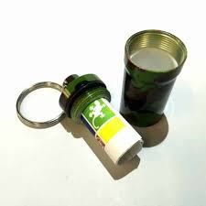
Other Tips
Carry a pen or pencil. Keep extras in your caching bag and your car.
Pens can freeze in cold weather!
Replace it exactly as you found it! You may think you are helping by moving the cache to a ”better” spot, but you could be compromising the integrity of the cache. If you think it is wrong, message the CO so they can fix it if needed.
Logs in the lid.

Slide 39
04
Advanced Topics
Trackables, Pathtags, alternative apps, and more.

Slide 40






Physical Caches
Traditional
Multi-Cache
Mystery/Puzzle
Letterbox Hybrid
Wherigo
Geocaching HQ
Notes:
Physical Caches
Traditional – The original!
Multi-Cache – Visit multiple locations to find the final container and claim the find.
Mystery/Puzzle – The “catch-all” type, they often require solving a puzzle to determine the final coordinates. Challenge caches also use this type.
Letterbox Hybrid – A cache that is also a letterbox. Usually contains a stamp meant to remain in the container. Sometimes found by descriptive navigating instead of GPS coordinates.
Wherigo – Use certain models of GPSr or a separate smartphone app to play a GPS-enabled adventure game to lead you to the final cache.
Geocaching HQ – there’s only one!
Project A.P.E. – Only two left in the world! First of the grandfathered cache types. In 2001, fourteen caches were placed in conjunction with 20th Century Fox to support the movie Planet of the Apes. Each geocache represented a fictional story in which scientists revealed an Alternative Primate Evolution. These geocaches were made using specially marked ammo cans and contained an original prop from the movie.

Slide 41





Caches Without a Container
EarthCache
Virtual
Webcam
Locationless
Adventure Lab
Notes:
No Container
EarthCache - An EarthCache is a special place that people can visit to learn about a unique geoscience feature of our Earth. EarthCache pages include a set of educational notes along with cache coordinates. Visitors to EarthCaches can see how geological processes have shaped our planet, how we manage its resources and how scientists gather evidence to learn about the Earth. They have separate guidelines and reviewers.
Virtual - A grandfathered geocache type where geocachers discover locations rather than containers. The requirements for logging a Virtual Cache vary—you may be required to answer a question about the location, take a picture, complete a task, etc. In any case, you must visit the coordinates before you can post your log. These are still available to find, but cannot be created outside of virtual rewards.
Webcam - A grandfathered geocache type using existing web cameras placed by individuals or agencies that monitor various areas such as parks or business complexes. The idea is to get yourself in front of the camera to log your visit, then use a smartphone or ask a friend on a computer to look up the website displaying the camera shot. You or your friend must save the picture in order to log the cache. These are still available to find, but no longer available for creation.
Locationless (Reverse) - A grandfathered cache type considered the opposite of a Traditional Cache. Instead of finding a hidden container, geocachers locate a specific object and log its coordinates. Locationless Caches are no longer supported on geocaching.com.
Adventure Lab – Uses a separate app for location-based tours. Visit a a locator and enter a keyword in the app to claim a find. No containers required. Can be located inside.

Slide 42
CashtonGS
Partner with a more experienced cacher. It will get easier after your first 100 when you’ve learned some of the ropes. Attend events to meet people if you don’t know local cachers.

Slide 43








Events
Event
Cache In Trash Out (CITO)
Mega Event
Giga Event
Geocaching HQ Block Party
GPS Adventure Maze
Geocaching HQ Celebration
Community Celebration Event
Notes:
Events
Event – a gathering of at least two geocachers.
Cache In Trash Out (CITO) – Event dedicated to cleaning up parks and other cache-friendly places around the world.
Mega Event – An event with at least 500 or more attendees. Often held annually. Example: West Bend Cash Ba$h (just not in 2020).
Giga Event - An event with at least 5000 or more attendees. There has only been one ever in the US (GeoWoodstock in 2018 in Cincinnati).
GPS Adventure Maze – A traveling educational exhibit developed to teach people of all ages about navigation, GPS technology and geocaching. A hands-on experience that features GPS technology (its history, current uses and future possibilities), it simulates geocaching by leading visitors through a maze rich with interactive science experiences.
Geocaching HQ Celebration – Originally known as the Groundspeak Lost and Found Celebration. It’s an event hosted by Geocaching HQ every 10 years in Seattle, WA.
Community Celebration Event – Originally know as a Lost and Found Event, they’re available to host every 10 years.

Slide 44
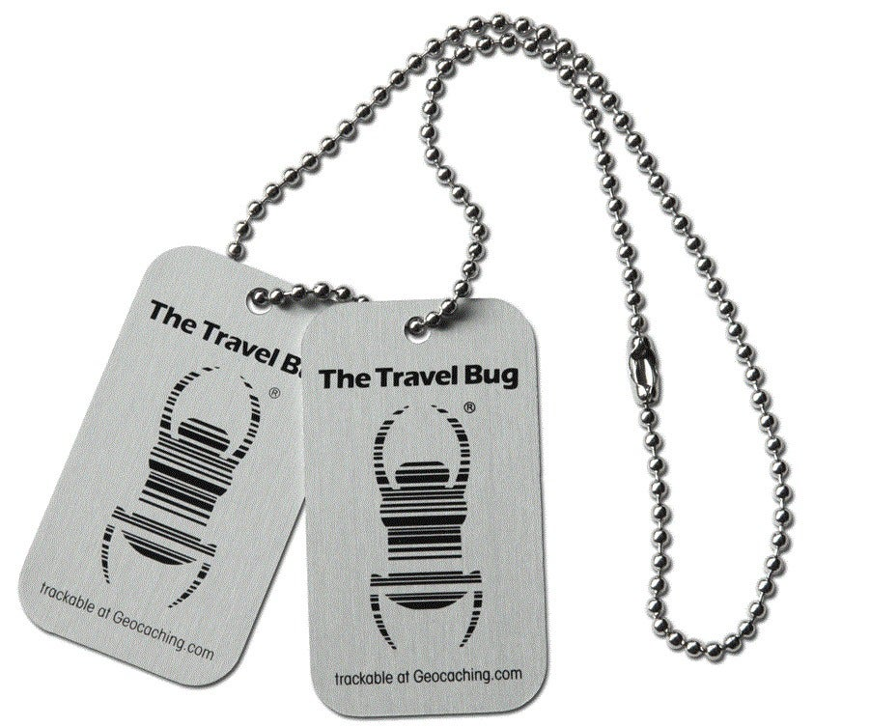
Trackables
Not typical SWAG.
Trackable items take many forms, but always have a tracking code on them.
They are meant to travel from cache to cache, with progress tracked online.
Most have a specific goal.
Only take a trackable from a cache if you are willing to log it online and help it toward its goal by placing it in another cache.

Slide 45
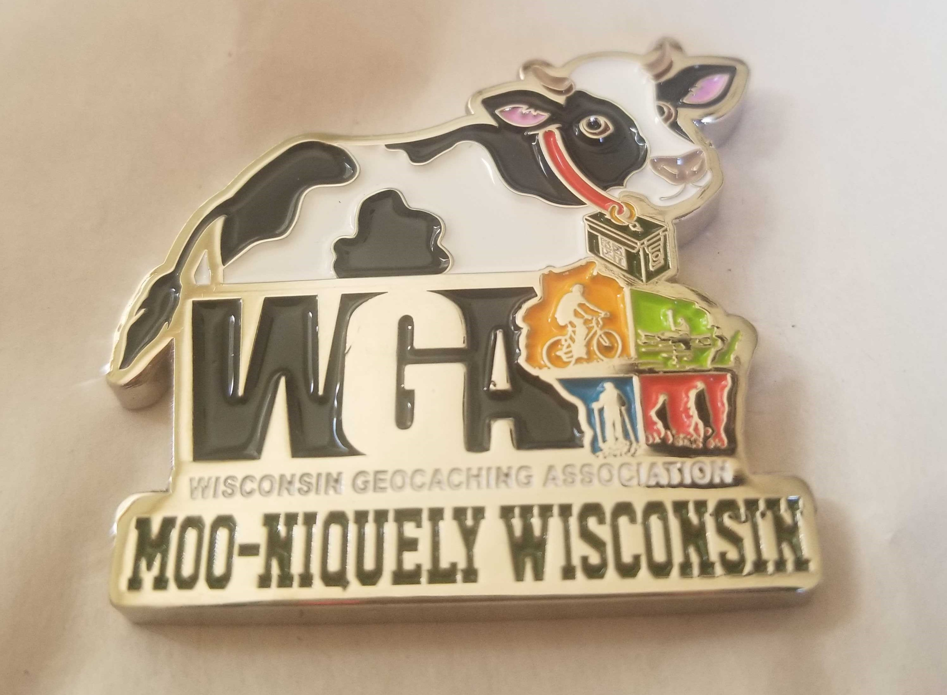
Geocoins
Custom-minted, trackable coins. Due to their higher value, they are often kept in personal collections instead of placed in caches to travel.

Slide 46
Logging Trackables
Discovered It – You saw the item but didn’t take it.
Retrieved from Cache – You found and took the item from the cache indicated in the last log.
Retrieve from Somewhere Else – You found and took the item from somewhere other than the last logged cache.
Dropped Off in Cache – You took the item to a new cache and left it there.
Visited Cache – You took the item to a cache but didn’t leave it. Also known as dipping.
Mark as Missing – The item has not been successfully logged in a long time and is not where it is supposed to be according to the last log. Only available to trackable/cache owners.
Write Note – A log that doesn’t fit the others. Maybe you want to add some photos. Or maybe you want to let the owner know the item wasn’t in the last cache where it was logged, but you don’t have access to Mark as Missing.

Slide 47
ACME_WildCachers
Geocaching has a lot to offer! You don’t need to learn everything right away. Each geocaching experience can only be new once. Take your time and enjoy each one!

Slide 48




Pathtags
One type of custom-designed personal signature item.
Single-sided metal tag about the size of a quarter.
Can be found in caches or traded at events.
They are not trackable on geocaching.com, so it’s OK to take and keep one for yourself.
Manage and track your collection at pathtags.com.

Slide 49
Chatauqua560
If you think you are going to stick with it and eventually want to fill your calendar, save the caches close to home for days you need to fill when the weather is not so great.

Slide 50
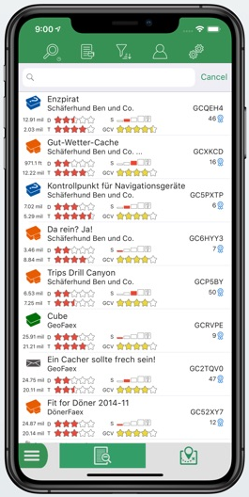
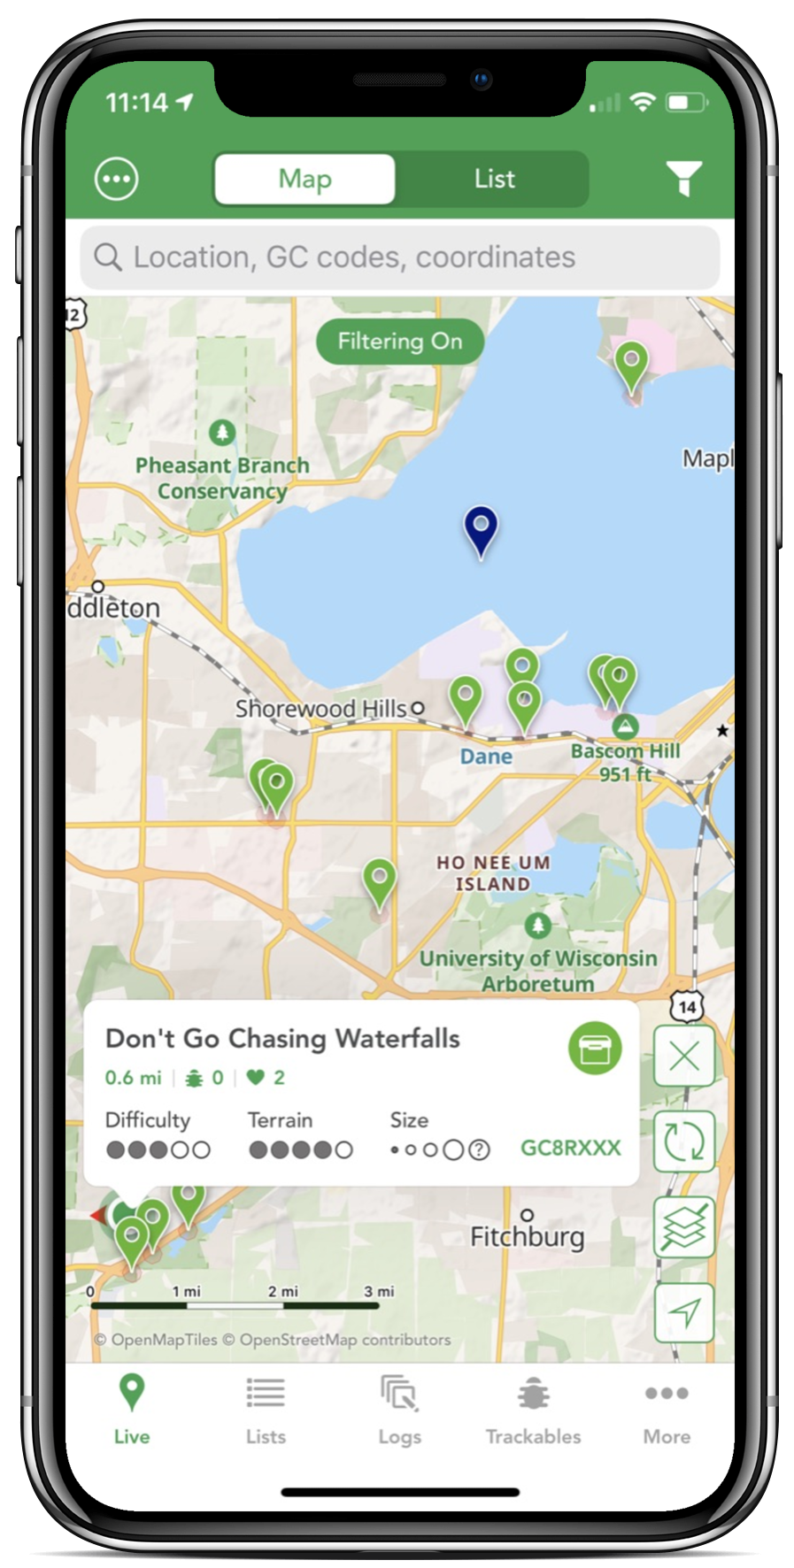
Alternative Apps for iOS
Cachly
Looking4Cache
$4.99 one-time purchase
$2.99 one-time in-app purchase for Premium Offline Maps
Lite version is free
$5.99 for Pro

Slide 51
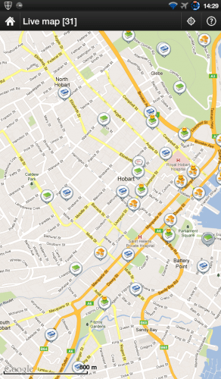
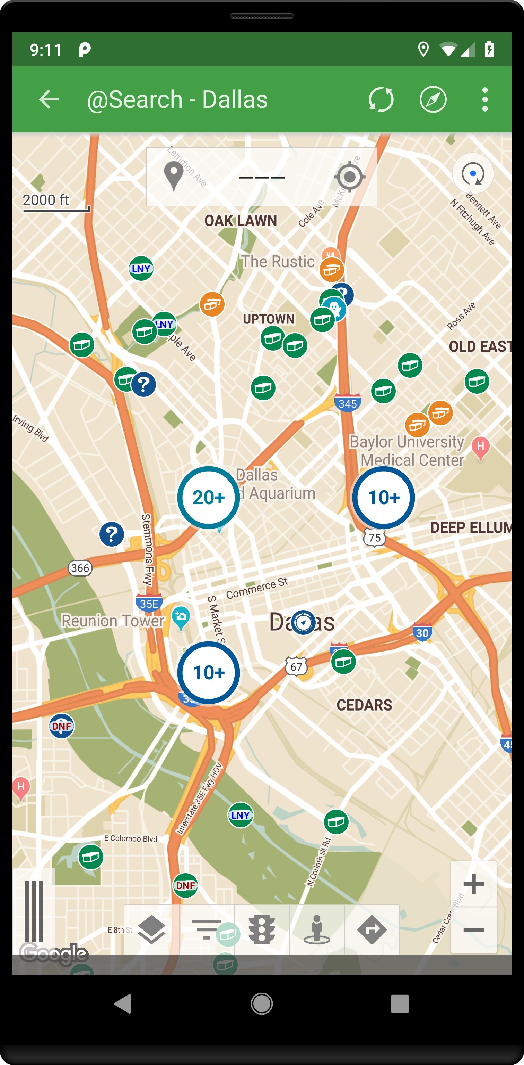
Alternative Apps for Android
c:geo
Geooh Go
Free
$4.99 one-time purchase
$0.99 semi-annual subscription for enhanced features

Slide 52
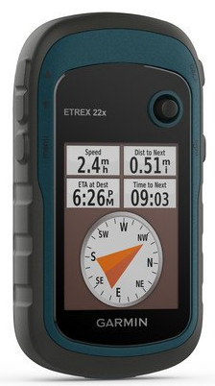
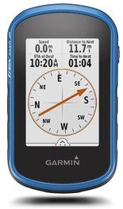
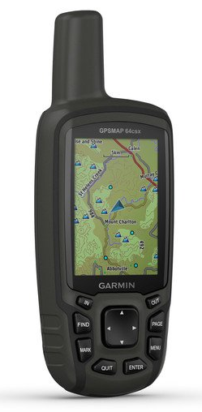
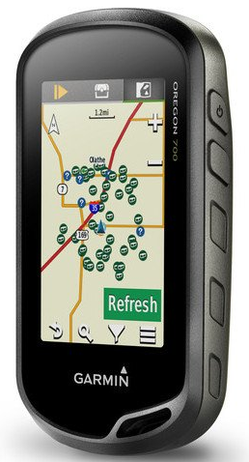
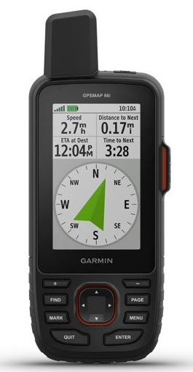
Garmin Handheld GPSr Options
eTrex
eTrex Touch
GPSMAP 64x
Oregon 700/750
GPSMAP 66

Slide 53
WiscBikeGal
Don't let anyone else tell you the "right" way to cache. Experienced geocachers often are going for the numbers, or difficulty, or some sort of challenge achievement. Just enjoy finding something hidden wherever you are. It shouldn't be a burden that you HAVE to do.

Slide 54
Resources
Geocaching HQ
www.geocaching.com
www.geocaching.com/help/ - Help Center
forums.geocaching.com/GC/
www.geocaching.com/blog/
shop.geocaching.com
GPSrs and Apps
www.cach.ly
www.cgeo.org
geooh-go.com
www.looking4cache.com
Podcasts
Geocache Talk
The Geocaching Podcast
GeoGearHeads
Inside Geocaching HQ
PodCacher
EarthCaches
www.earthcache.org
Other Tools
www.project-gc.com – Statistics and Planning
www.geocachingtoolbox.com – Puzzle Tools

Slide 55
Questions?

Slide 56
rawevil
The WGA is a great resource for everything from hiding to finding to events. The website is a great tool.

Slide 57




Wisconsin Geocaching Association
We are a group of fun-loving, enthusiastic, outdoor-minded people who like to geocache, and we want to help others do the same.
Join us for community, games, and more!
Wisconsin Geocaching Association
@WIGeocaching
wigeocachingassociation

Slide 58
Thank You!

